Slide 1


Slide 2
Equilibrium of two force system
If a body is in equilibrium and is acted upon by only two forces then these two forces must be in equal magnitude, opposite in direction and collinear.
F₁
A
B
F₂

Slide 3
Equilibrium of two force system
If a body is in equilibrium and is acted upon by only two forces then these two forces must be in equal magnitude, opposite in direction and collinear.
F₁
A
B
F₂

Slide 4
Equilibrium of two force system
If a body is in equilibrium and is acted upon by only two forces then these two forces must be in equal magnitude, opposite in direction and collinear.
F₁
A
B
F₂

Slide 5
Equilibrium of three force system
If a body is in equilibrium and subjected to three forces coplanar forces then the force system acting on the body should be either concurrent or parallel force system.
F₃
C
O
A
B
F₁
F₂
R (of F1 & F2)

Slide 6
Equilibrium of three force system
If a body is in equilibrium and subjected to three forces coplanar forces then the force system acting on the body should be either concurrent or parallel force system.
F₃
C
O
R (of F1 & F2)

Slide 7

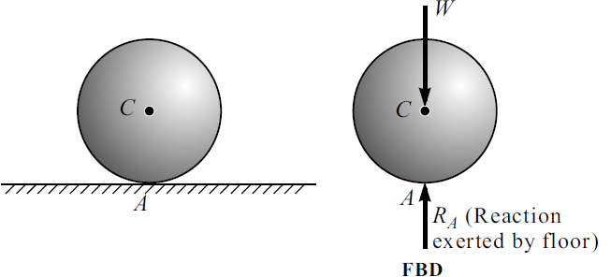

Slide 8
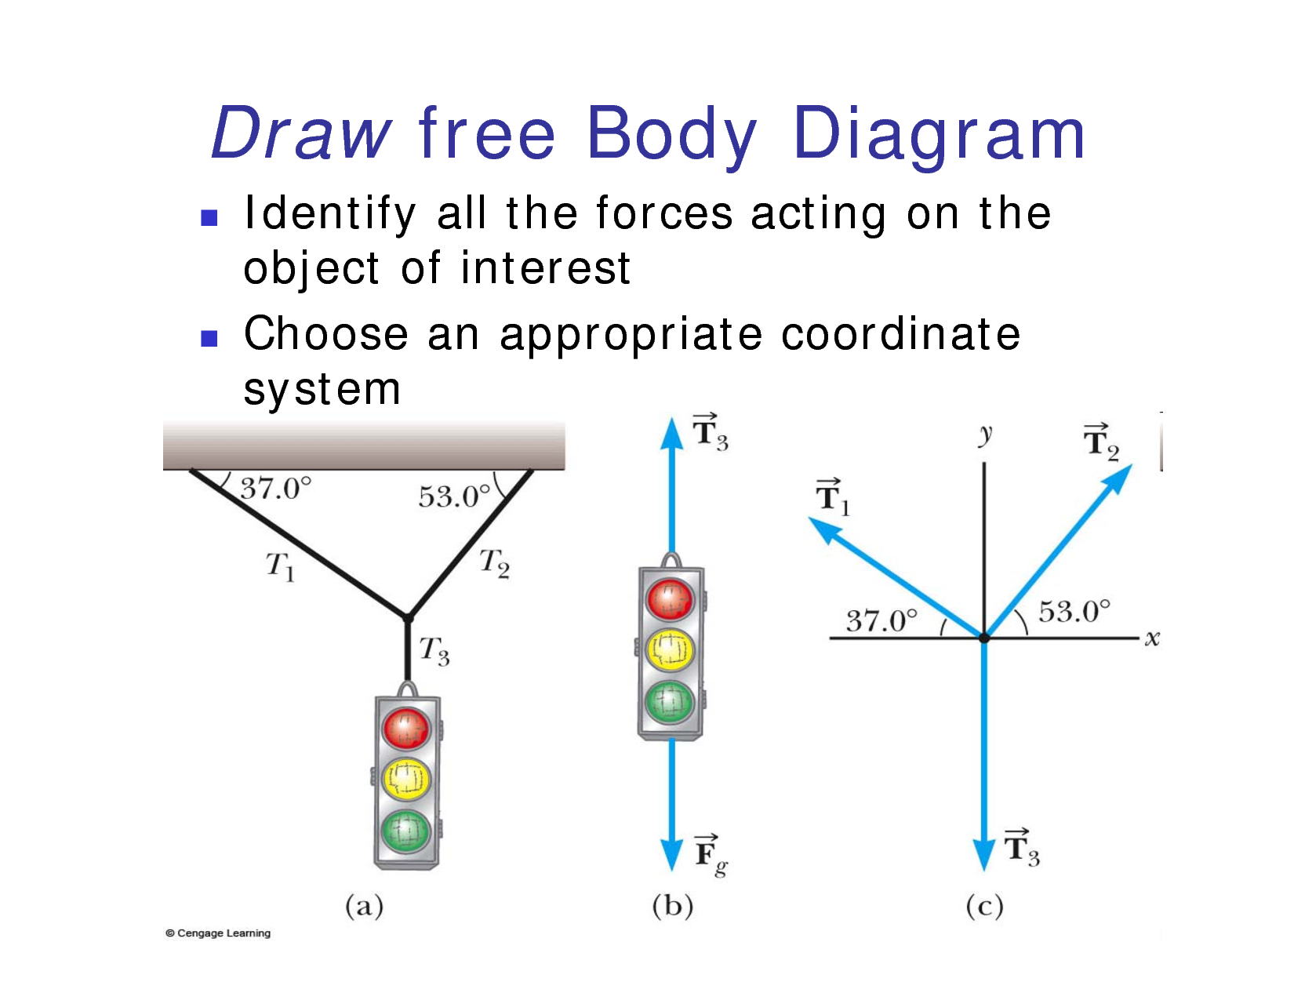

Slide 9

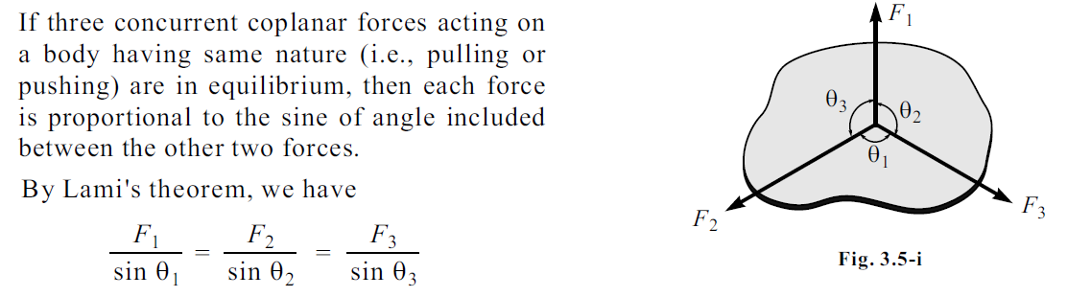

Slide 10
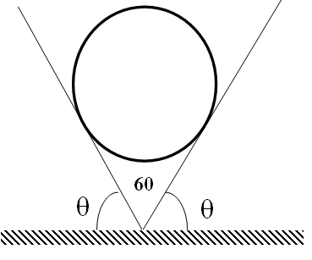
Find the reaction offered by surfaces. Weight of sphere = 100 N

Slide 11
Find the reaction offered by surfaces. Weight of sphere = 100 N
₉₀
₉₀
_{R2}
_{R1}
₆₀
₆₀
_{W}

Slide 12
₉₀
₉₀
?◦
?◦
_{R2}
_{R1}
₆₀
₆₀
_{W}
R₁
R₂
30◦
30◦
100 N

Slide 13
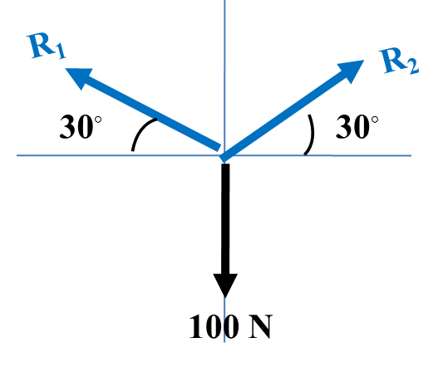
120◦
R₁
R₂
120◦
30◦
30◦
120◦
100 N
R₁ = R₂ = 100 N

Slide 14
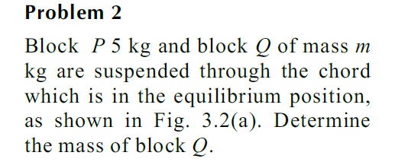
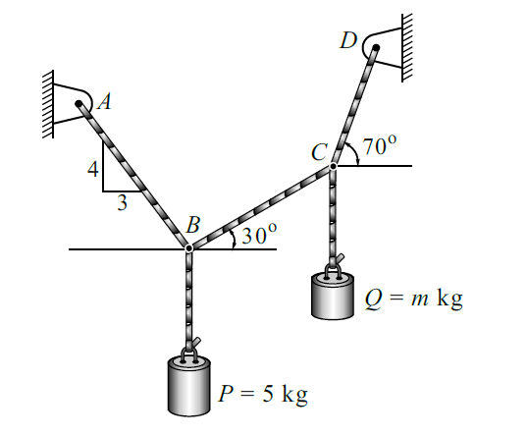

Slide 15
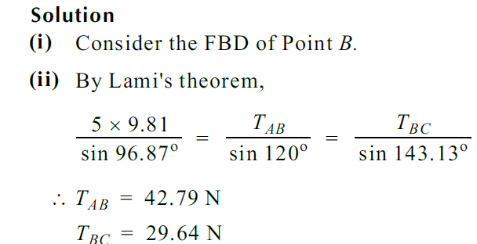
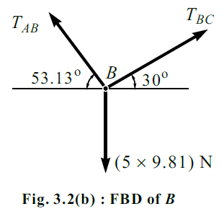

Slide 16
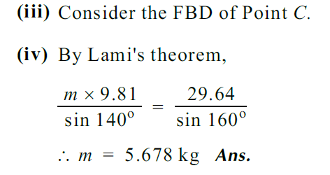
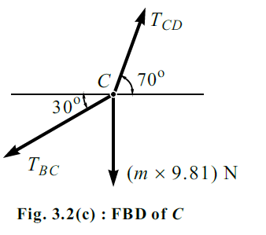

Slide 17
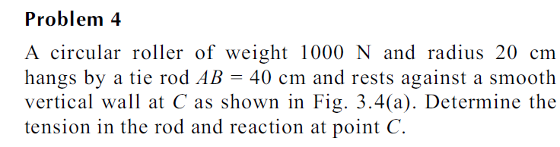
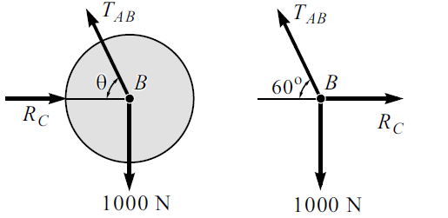
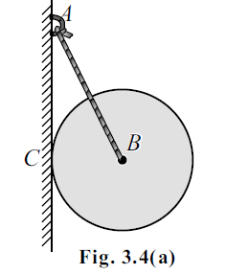

Slide 18
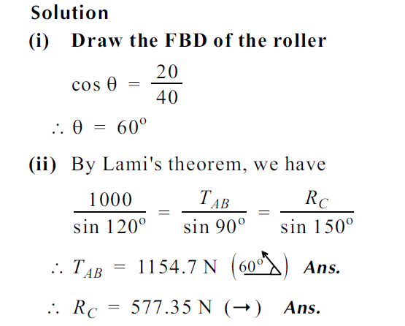

Slide 19
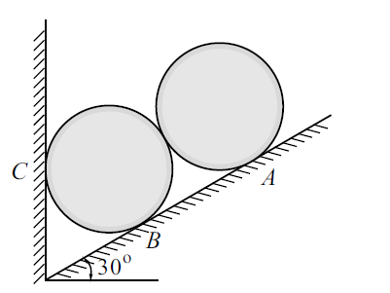
Two identical rollers each of mass 50 kg are supported by an inclined plane and a vertical wall as shown in figure. Assuming smooth surfaces, find the reactions induced at the point of support A, B and C.

Slide 20
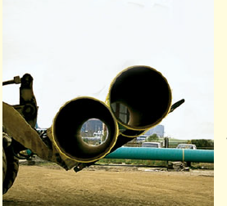

Slide 21
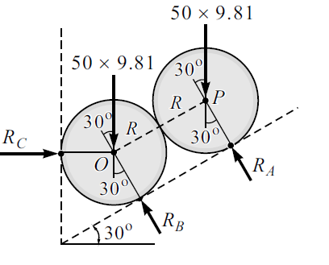

Slide 22
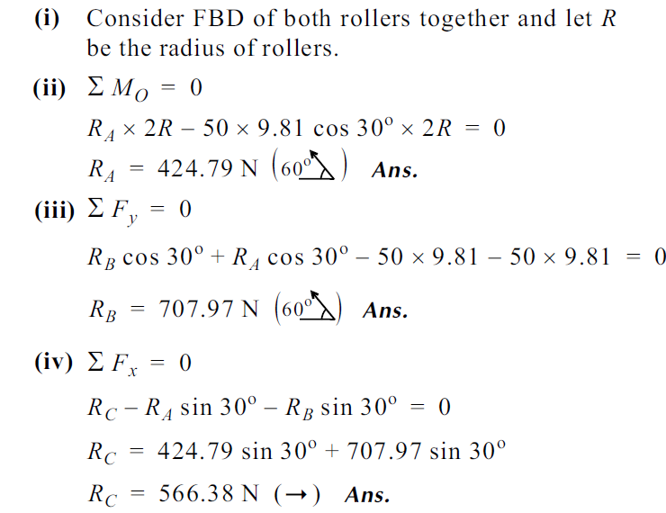

Slide 23
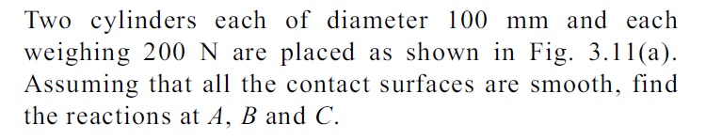
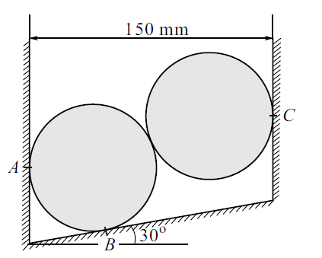

Slide 24
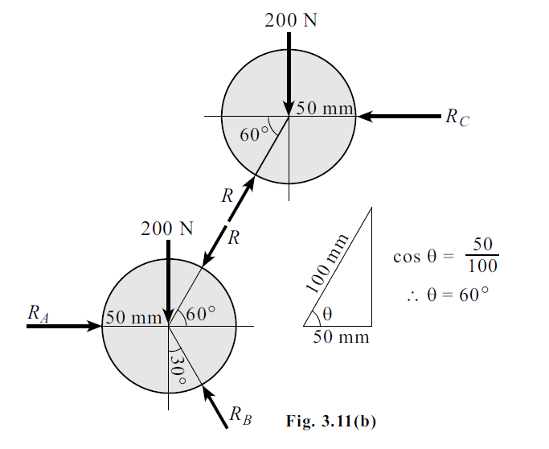

Slide 25

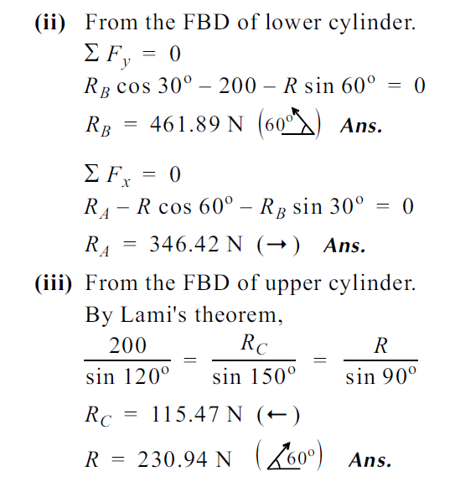

Slide 26
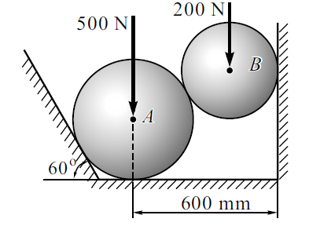
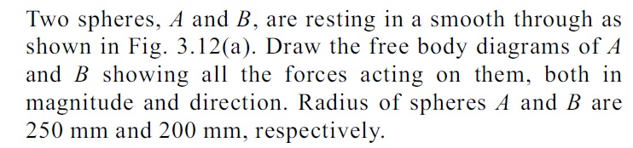

Slide 27
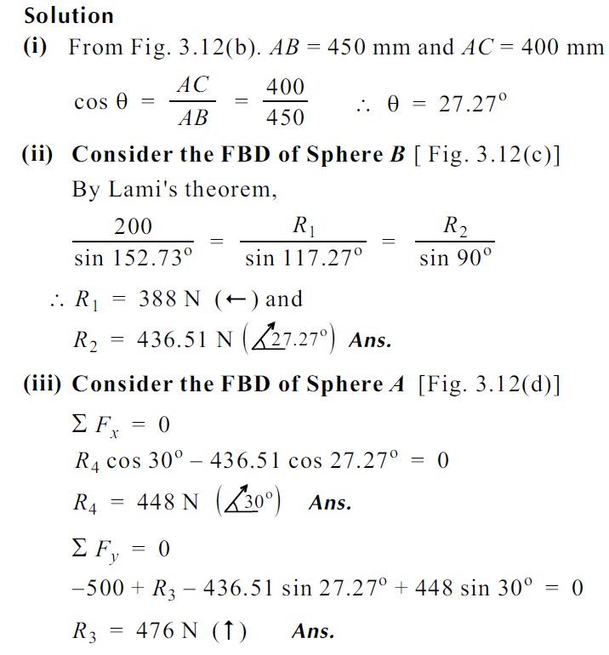

Slide 28
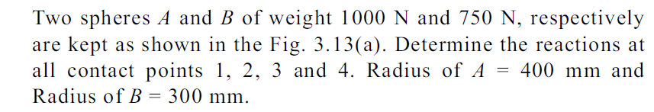
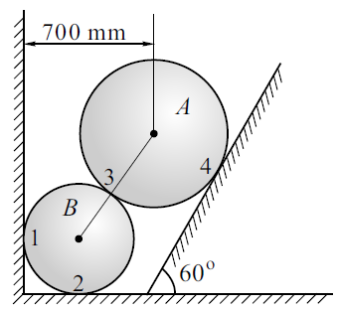





Slide 29

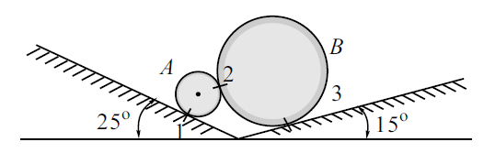

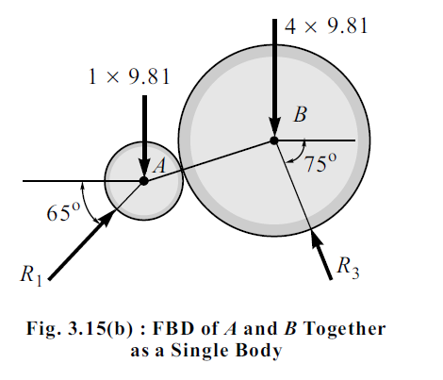

Slide 30
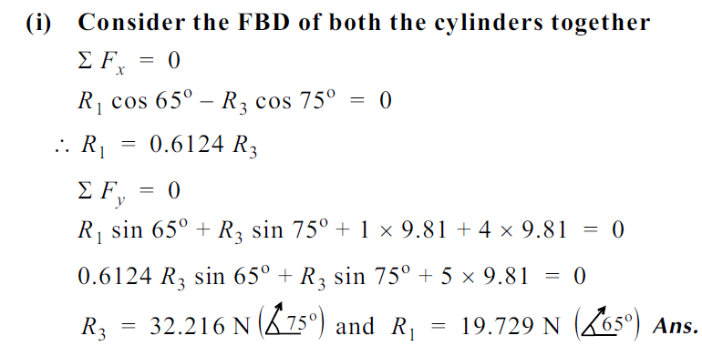
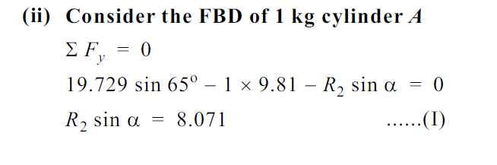

Slide 31
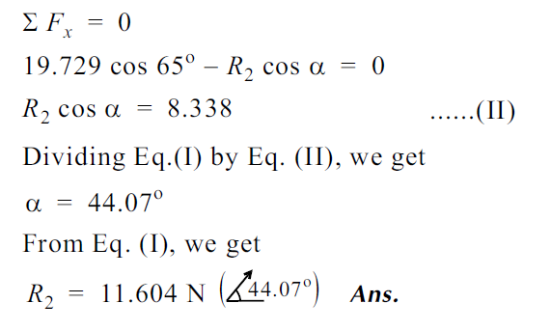
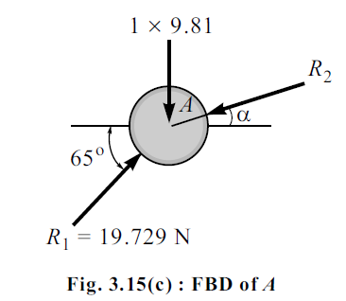

Slide 32
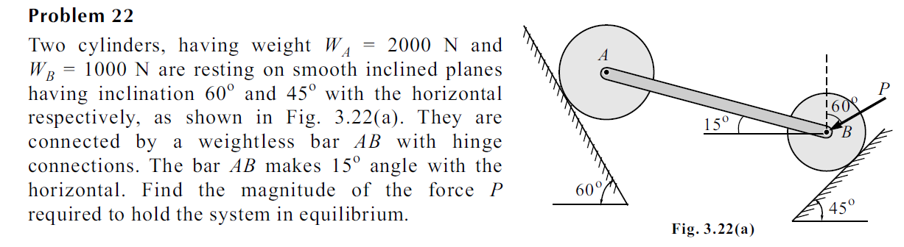
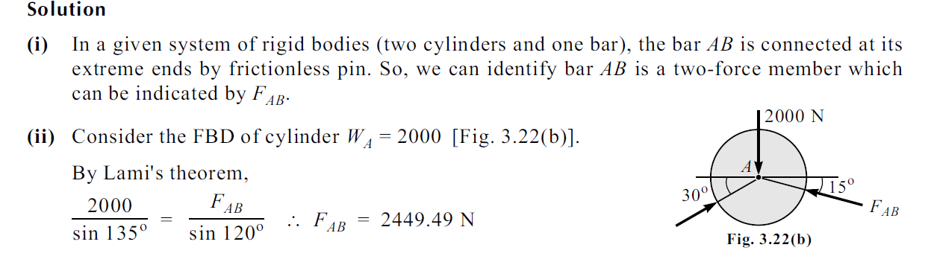

Slide 33
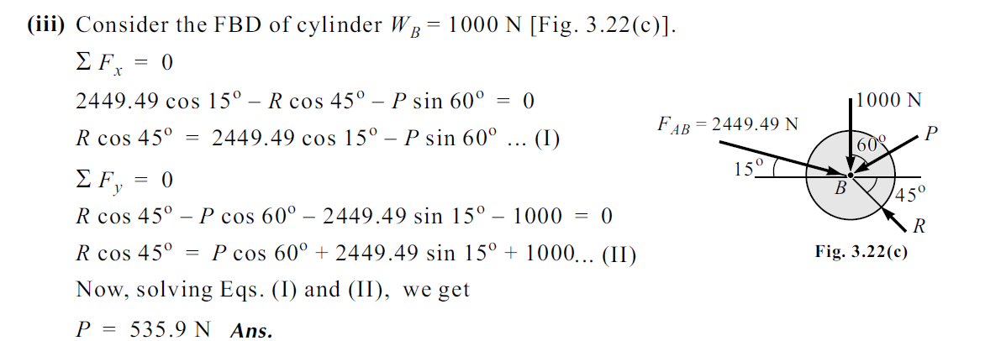

Slide 34
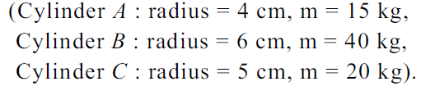
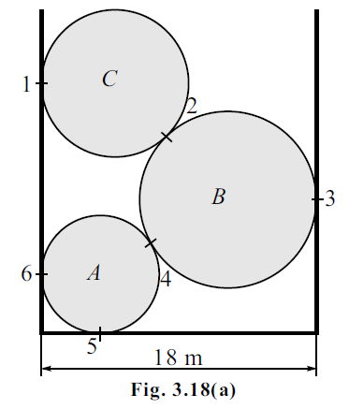
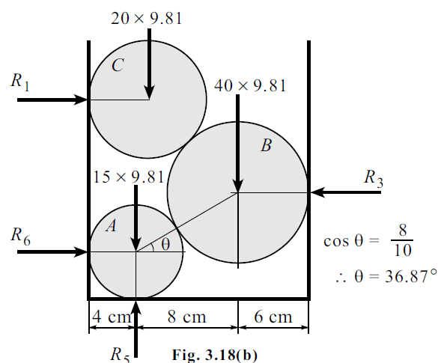

Slide 35
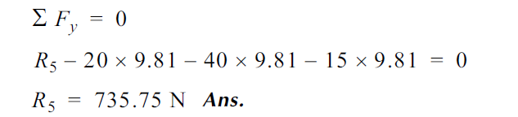
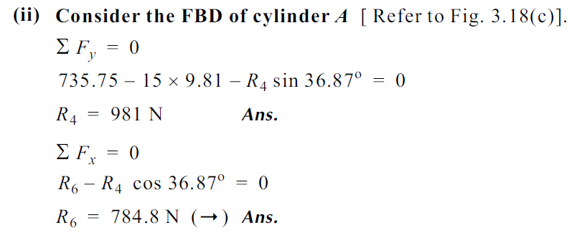
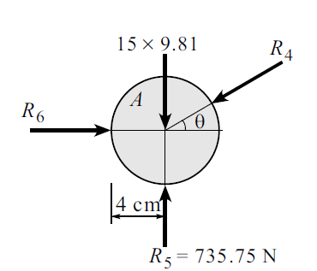

Slide 36
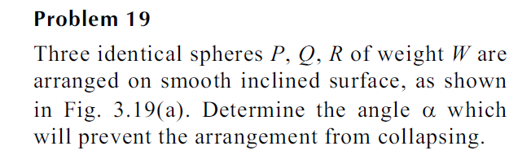
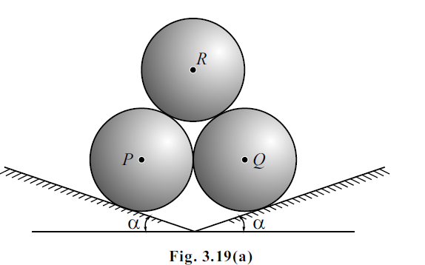

Slide 37
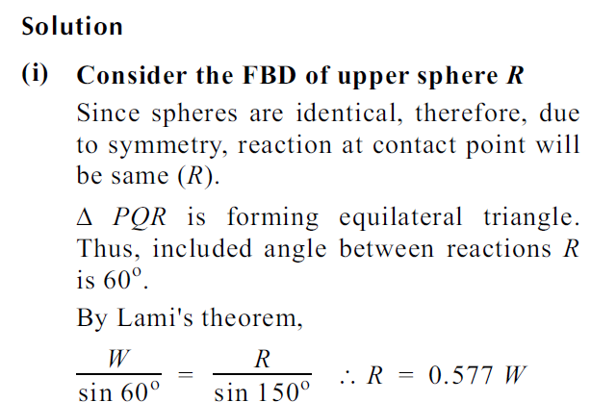

Slide 38
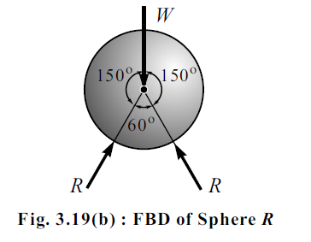

Slide 39
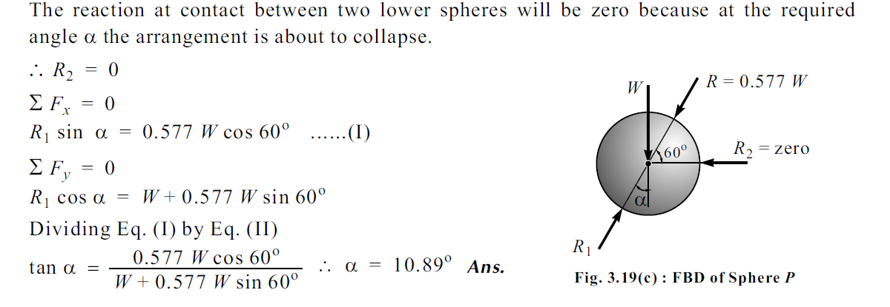

Slide 40
Two smooth balls A and B, having respective mass of 2 kg and 5 kg rest between the inclined plane. Determine the reactions of planes on balls. The radius of both balls is same. Assuming smooth surfaces.
₂₀◦
_{B}
_{A}
₅₀◦
₂₀◦

Slide 41
Two smooth balls A and B, having respective mass of 2 kg and 5 kg rest between the inclined plane. Determine the reactions of planes on balls. The radius of both balls is same. Assuming smooth surfaces.
₂₀◦
_{B}
R₃
_{A}
₅₀◦
₂₀◦
R₁
R₂

Slide 42
Two smooth balls A and B, having respective mass of 2 kg and 5 kg rest between the inclined plane. Determine the reactions of planes on balls. The radius of both balls is same. Assuming smooth surfaces.
₂₀◦
_{B}
30.58 N
_{A}
₅₀◦
₂₀◦
46.09 N
38.0 N

Slide 43
Two smooth spheres each of radius 100 mm and weighing 100 N, rest in a horizontal channel having vertical walls, the distance between which is 360 mm. Find the reactions at the points of contact A, B, C and D as shown in figure.
360 mm
B
A
D
C

Slide 44
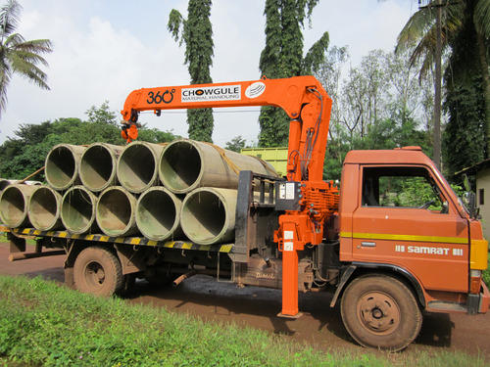

Slide 45
360 mm
B
A
D
C
R_{A} = 133.33 N
R_{B} = 166.66 N
R_{C} = 200 N
R_{D} = 133.33 N

